Slide 1
Open Day Guide

Slide 2
Why attend Open Days?

Slide 3
Why attend Open Days?
Choosing what you want to do after you leave school / college is a big decision. It’s important to do your university research early so you can find out what’s right for you. Attending Open Days let’s you:
Discover hundreds of courses available.
Find out what makes them different at Ulster University.
Meet the course lecturers in person.
Experience our world-class facilities.
Ask questions and get the answers you need.
Explore the many sports clubs and societies can you join.
Decide whether the university is right for you.

Slide 4
Why attend Open Days?
Open Days are an important part of your university research. You should use the opportunity to help you make an informed decision about where you want to be after school or college.
This guide is designed to help you prepare for attending Open Days at Ulster University, and how to make the most of them.
#READY
FOR UU

Slide 5
Before you arrive.

Slide 6
Before you arrive
It’s important to do some research about Ulster University before you attend our Open Days. Here are some handy tips to best prepare for attending UU Open Days:
Browse courses of interest on our Online Prospectus, so you have something to find out more about during your visit.
Register for subject talks, activities and sessions to receive text message reminders shortly before they begin.
Plan your day and pick 5 things you either want to see, experience, find out more about or get involved in, to ensure you make the most of your time on campus.
Become familiar with our campuses before you arrive. Take a quick look at the campus maps in the next few slides so you know exactly where you need to go.

Slide 7
Finding our campuses.

Slide 8
Finding our campuses
With over 26,000 students and as the 2nd largest university in Ireland, we have some serious real estate!
Ulster University is located across 4 campuses in Northern Ireland. Depending on which course you choose, you will be based on a specific campus – each with it’s own vibrant student community – and finding us couldn’t be easier…
Belfast | York Street, Belfast, BT15 1ED
Coleraine | Cromore Road, Coleraine, BT52 1SA
Jordanstown | Shore Road, Newtownabbey BT37 0QB
Magee | Northland Road, Derry⁓Londonderry, BT48 7JL
In the next few slides, you’ll find aerial view maps of each of our
campuses to help you familiarise yourself with the areas.

Slide 9
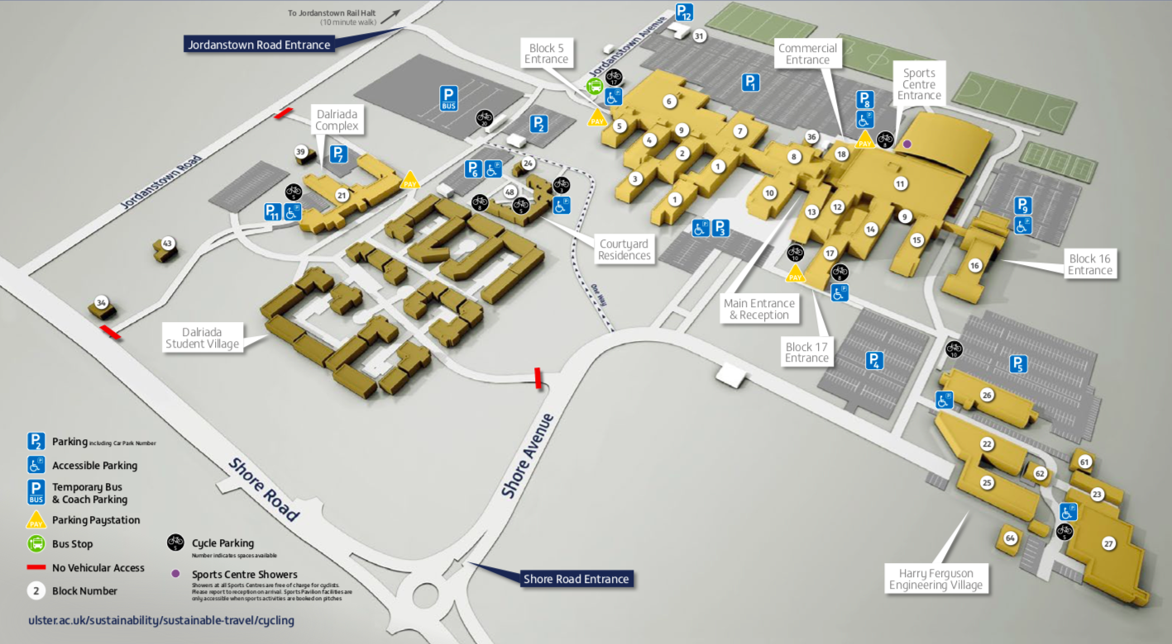

JORDANSTOWN

Slide 10
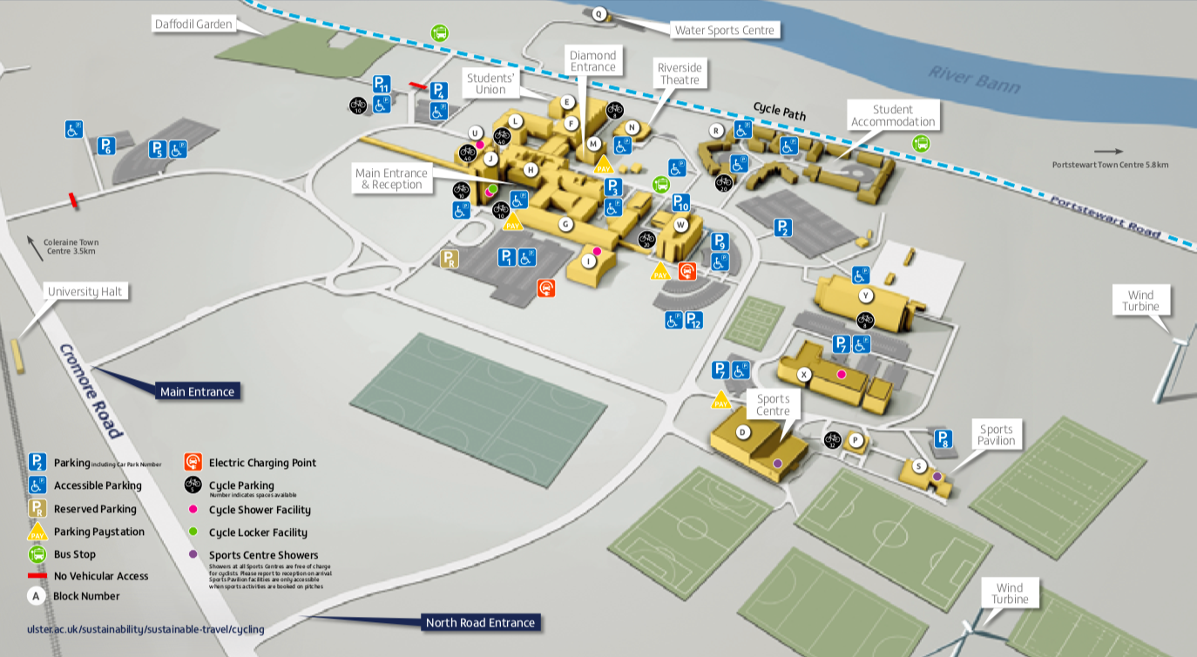
COLERAINE

Slide 11
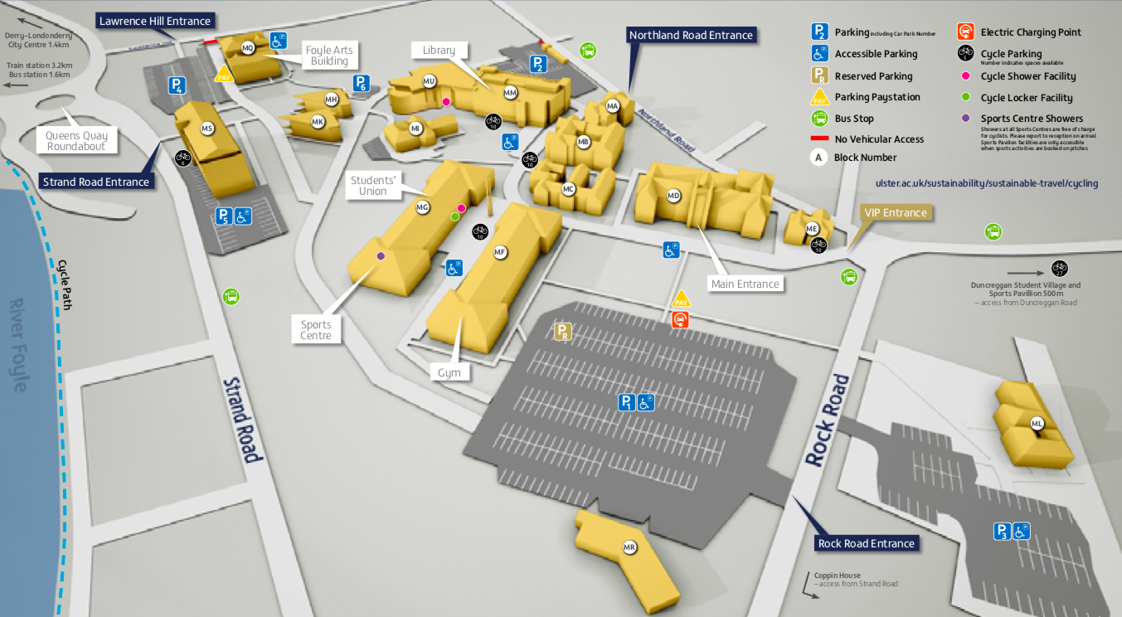
MAGEE

Slide 12
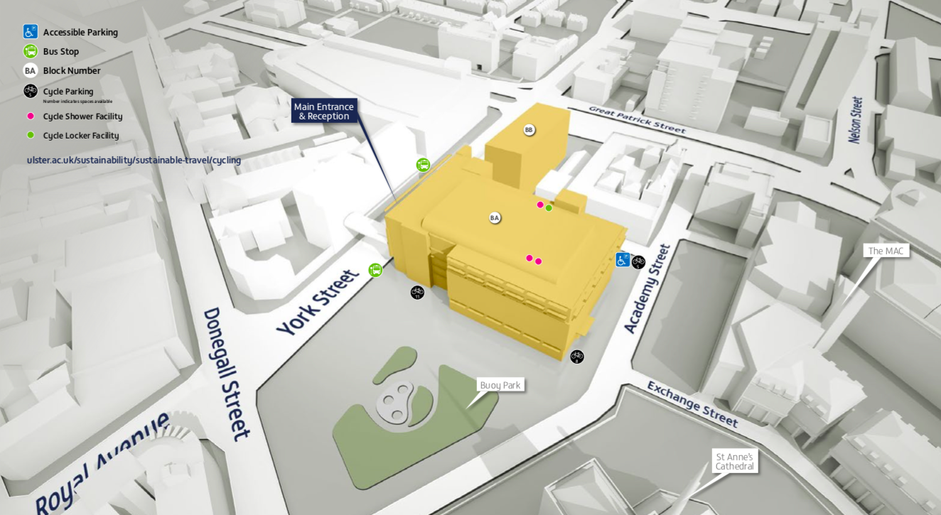
BELFAST

Slide 13
How to HACK your university Open Day

Slide 14
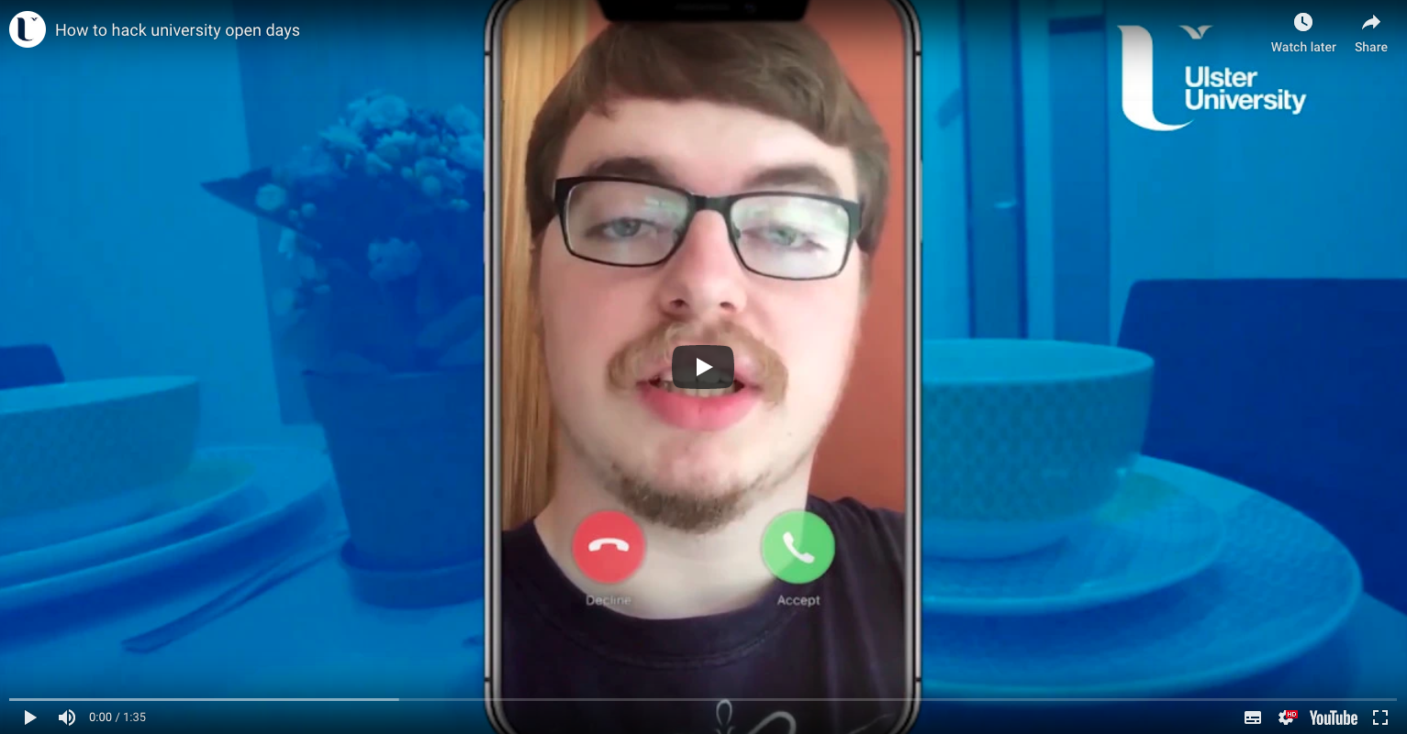
CLICK
TO WATCH

Slide 15
Hacking Open Days | 5 tips
To recap, you’ll be able to make the most of your Open Days by:
Attend subject talks.
Take campus tours ^{(explore your surroundings!)}
Ask Questions ^{(and get answers)}
Sign up for activities ^{(have fun and get involved)}
Find out more about our Clubs & Socs.

Slide 16
Get Social!
(& win prizes!)
📱
👍

Slide 17

Get Social!
(& win prizes!)
Feeling social? Well, we are, and we want you to get social with us.
To be in with a chance of winning a fabulously stylish Ulster University branded hoodie, we want you to Tweet, Snap, and Insta your way around campus during Open Days, showing us your experience and adventure of the campus.
We want to see your best selfies, with your friends, teachers or even strangers! …and share it with us on all your social channels using #ReadyforUU. Don’t forget to use our UU Snapchat / Instagram filters to really up your game!
We’ll pick out the best and most creative selfies, live-streams and other weird and wonderful ways of showing the world your experience at Ulster University.
…Psst! There’s 100 hoodies to be won!
#READY
#READY
#READY
#READY
FOR UU
FOR UU
FOR UU
FOR UU

Slide 18
We want to meet your family.
Not joking!

Slide 19
Family Open Days
Alright... So we we’re kind of joking.
But there’s more to UU than just one campus, and we want to give you as much opportunity to experience all 4 campuses before you make your decision.
To ensure you have as much opportunity to visit our campuses, we are hosting Family Open Days on Saturdays in September & October. This will allow you and your family to visit the campuses and the locations in which they’re embedded, so you can get a true vibe as to what life is like as a Coleraine, Belfast, Magee and Jordanstown student.
Each of our campuses has something different to offer; a different pulse, subject offering, facilities and sports clubs & societies. B
So bring your family along and experience more at Ulster.
9.30am – 2pm
Jordanstown | Saturday 7 September
Magee | Saturday 21 September
Coleraine | Saturday 28 September
Belfast | Saturday 5 October

Slide 20
And finally…

Slide 21
And finally…
HAVE FUN!
Open Days aren’t supposed to be scary, they’re meant to be fun. Let your Open Day be a chance for you to explore, engage and experience what life at Ulster University could be like, so you can make a confident choice about what’s right for you.
Ready?

